Slide 1

Autism Prediction using Machine Learning
Submitted In Partial Fulfillment of the Requirement for the Degree of
Bachelor of Technology in Information Technology
By- Ashmit Saini (210060103028)
Under the Supervision of
Mr. Sunil Singh (Assistant Professor)

Slide 2

ABSTRACT
This project demonstrates the potential of machine learning in early ASD prediction using behavioral and demographic data. With high model accuracy and interpretability, it offers a scalable, accessible diagnostic support tool. Future work includes clinical validation, real-time integration, and use of multi-modal data for broader applicability and improved precision.
Though promising, the model requires validation on diverse datasets. The study lays a foundation for real-time, accessible diagnostic tools integrated with mobile apps and healthcare systems.

Slide 3

INTRODUCTION: WHAT IS AUTISM?
Autism Spectrum Disorder (ASD) is a lifelong neurodevelopmental condition that affects how a person communicates, interacts socially, and behaves. It is called a "spectrum" because symptoms and severity vary widely among individuals. Early signs often appear in childhood, impacting daily functioning, learning, and relationships throughout life.
ASD is characterized by repetitive behaviors, restricted interests, and difficulties in understanding social cues or engaging in typical conversation.

Slide 4

OBJECTIVE OF THE PROJECT
To develop a machine learning-based predictive model capable of identifying Autism Spectrum Disorder (ASD) in individuals using structured questionnaire responses and demographic data. The project aims to automate the diagnostic process, reduce reliance on clinical judgment, and improve early detection, particularly in under-resourced or remote areas with limited medical access.
To evaluate and compare various machine learning algorithms such as Logistic Regression, Support Vector Machine, Naive Bayes, and Random Forest for ASD prediction.

Slide 5
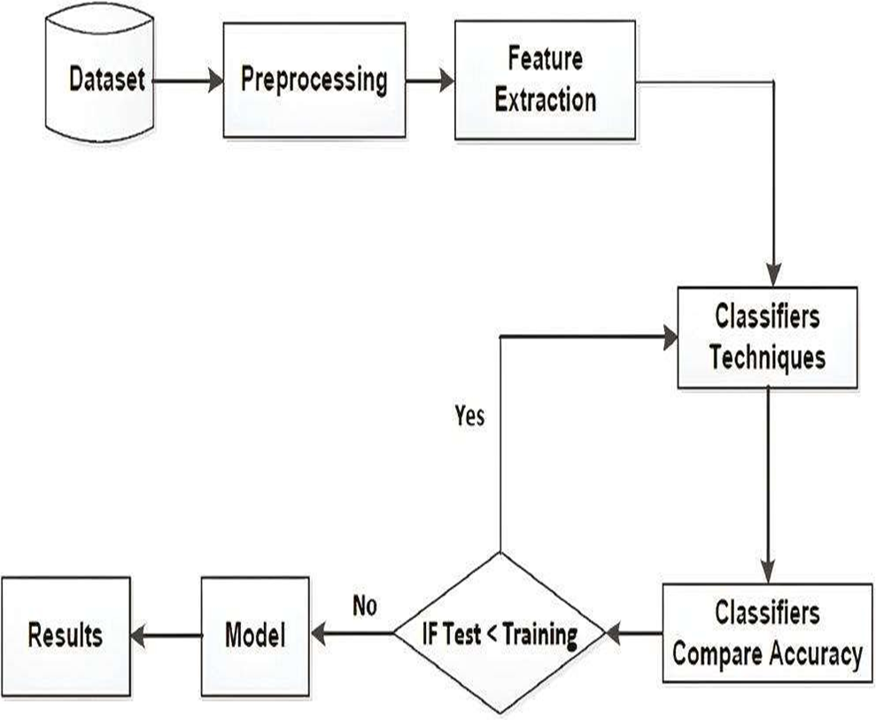
ARCHITECTURAL DIAGRAM OF THE SYSTEM....

Slide 6
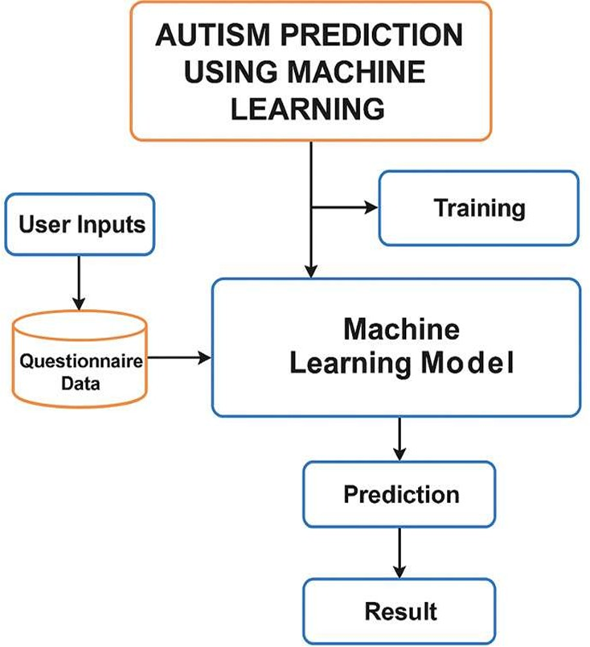
EXPLAINATION OF THE DIAGRAM
1. Dataset: Contains structured data like demographic details, questionnaire responses, and family history.
2. Preprocessing: Handles missing values, encodes categorical variables, and normalizes numerical data.
3. Feature Extraction: Selects the most relevant features to improve model performance and reduce computational cost.
4. Classifier Techniques: Applies ML algorithms like Logistic Regression, Random Forest, SVM, etc., for training.
5. Accuracy Check: Compares training and test accuracy to avoid overfitting.
6. Model Selection: Chooses the best-performing model using metrics like precision, recall, and F1-score.
7. Result Generation: Predicts autism likelihood to assist in early diagnosis and clinical follow-up.

Slide 7

TECHNOLOGIES USED IN THE PROJECT
Programming Language: Python
Data Manipulation and Numerical Computation
Data Visualization Tools
Machine Learning Algorithms
Development Environment
Dataset: Kaggle

Slide 8

Programming Language: Python
Python was chosen for its simplicity, readability, and beginner-friendly syntax, making it ideal for collaborative academic work. It supports rapid development and is widely used in data science due to powerful libraries like Pandas, NumPy, Scikit-learn, Matplotlib, and Seaborn, which simplify data handling, analysis, modeling, and visualization.
Python’s strong community support provides extensive tutorials, forums, and open-source tools, easing development and troubleshooting.

Slide 9

Machine Learning Algorithms
Machine learning algorithms play a crucial role in autism prediction by analyzing patterns in behavioral and demographic data. Supervised learning methods like Logistic Regression, SVM, XGBoost, and Naïve Bayes were used. Logistic Regression provides interpretability for binary classification, while SVM separates complex data using hyperplanes. Each model contributes unique strengths in prediction accuracy.
XGBoost excels with large, complex datasets through gradient boosting and regularization, handling missing values effectively. Naïve Bayes, implemented via Weka, is efficient and based on probabilistic principles. Models are trained, evaluated, and optimized to ensure reliable autism risk predictions using real-world healthcare data.

Slide 10

Development Environment
The project was developed primarily using Jupyter Notebook for its interactive and modular structure, allowing step-by-step code execution, real-time visualization, and seamless documentation with markdown and LaTeX support. It was ideal for data exploration, model training, and evaluation in an academic and research context.
Visual Studio Code (VS Code) was used for structured scripting, debugging, and version control integration. With support for Git and Python extensions, it enabled efficient project management and collaboration. GitHub was used for hosting code, tracking changes, and maintaining a clear development timeline throughout the project lifecycle

Slide 11

Dataset
The dataset used for this study is provided in the file titled train.csv, which contains structured records related to behavioral data and potentially relevant features that can be used to predict autism in individuals.
The dataset comprises a total of 913,000 entries and consists of the six attributes.
It is collected from the Kaggle.

Slide 12

Advantages of the Project
Early Detection – Enables timely identification of autism risk.
Scalability – Can be deployed widely, including remote areas.
Cost-Effective – Reduces reliance on expensive clinical evaluations.
Speed & Automation – Delivers quick results using structured input.
Interpretability – Uses explainable models (like SHAP) to support transparent decision-making for clinicians and caregivers.

Slide 13

Conclusion of the Project
This project successfully demonstrates the application of machine learning in predicting Autism Spectrum Disorder using behavioral and demographic data. Models like Random Forest and SVM achieved high accuracy, making them effective tools for early risk assessment. The system’s ability to automate screening provides valuable support in clinical decision-making.

Slide 14

Future Scope of the Project
The system can be enhanced by integrating multimodal data sources such as voice patterns, facial expressions, and eye-tracking to improve prediction accuracy. Incorporating these features alongside questionnaire data will enable more comprehensive behavioral analysis and better detection of subtle autism indicators.
There is significant potential for developing mobile and web-based applications to make autism screening more accessible, especially in rural or under-resourced areas. The model can also be integrated with telehealth platforms and electronic health records (EHRs) to support clinicians, facilitate large-scale screenings, and track patient progress over time for personalized interventions.

Slide 15
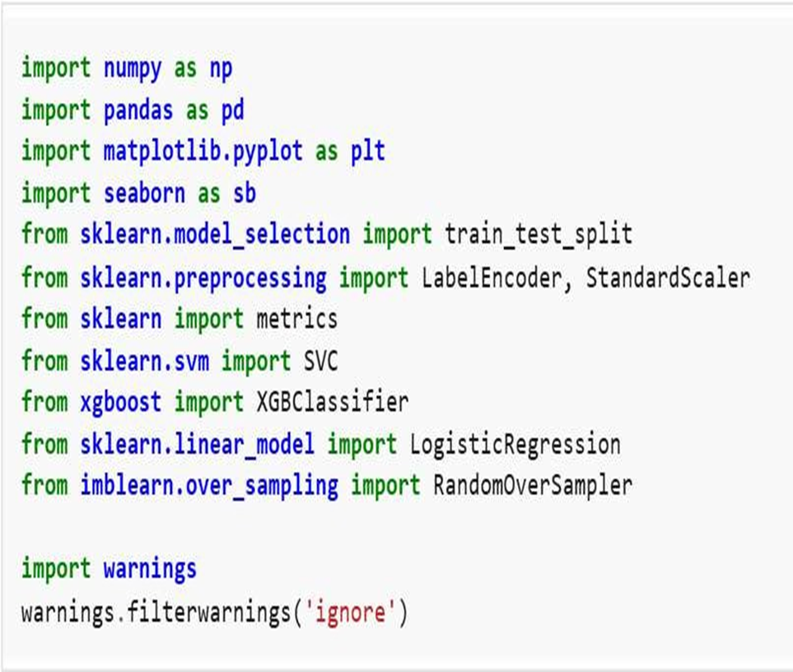

Slide 16
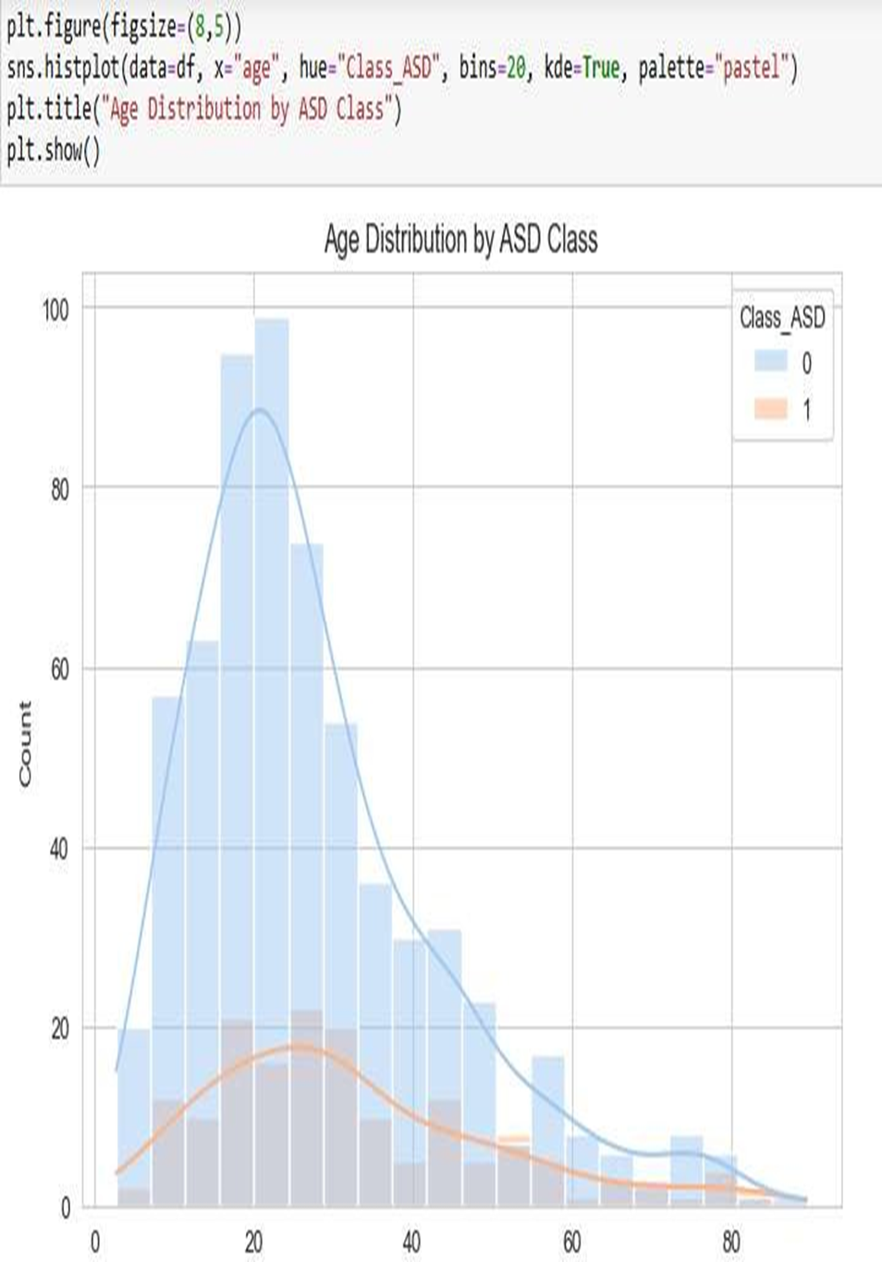

Slide 17
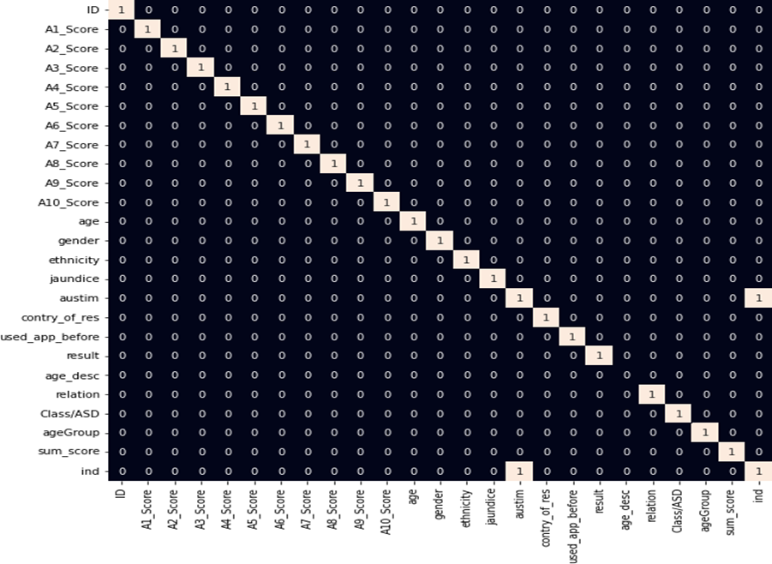

Slide 18


